Slide 1
SIKE Round 2 Speed Record on ARM Cortex-M4
Hwajeong Seo (Hansung University), SK
Amir Jalali (Florida Atlantic University), USA
Reza Azarderakhsh (Florida Atlantic University, PQSecure Technologies), USA
Presenter: Hyeokdong Kwon (Hansung University)

Slide 2
Outline
Short Overview
Supersingular isogeny key encapsulation (SIKE) protocol
Our implementation
Implementation results
Conclusion

Slide 3
Quantum Threat to Information Security
Large-scale quantum
computers could break some encryption schemes
Need to migrate encryption to quantum- resistant algorithms
When we should start the process?
Questions:
When will quantum computers arrive?
When will they be a threat?
When do we switch?
How do we have live and agile transition?
What do we transition to?
…
“In 25 years we’ll be working on quantum resistant crypto standardization based on elliptic curves in some way!”
─Dustin Moody, NIST (NSF CCC Workshop 2019)

Slide 4
Post-Quantum Cryptography (Isogeny)
Quantum-Resistant Cryptography
NIST launches the post-quantum cryptography standardization project
“The goal of this process is to select a number of acceptable candidate cryptosystems for standardization.”
Code, Lattice, Hash, Multivariate, Isogeny…

Slide 5
Quick Overview
[2006]: Birth of a supersingular isogeny-based cryptosystem
Charles – Goren – Lauter
built hash function from supersingular isogeny graph
[2011]: Supersingular isogeny key exchange
Jao – De Feo
[2017]: Supersingular isogeny key encapsulation
SIKE Team

Slide 6
Post-Quantum Cryptography (Isogeny)
Round1 (2017. 12) : 69 accepted as “complete and proper” (5 withdrew)
Round2 (2019. 01) : 26 accepted including SIKE
SIKE Round2
New parameters: SIKEp434, SIKEp610
Stronger security: SIKEp503 (1→2) SIKEp751 (3→5)

Slide 7












SIKE Team

Slide 8
Motivation
Type | Algorithm | Advantage | Disadvantage
Code | McEliece | Fast computation | Long key size
Hash | XMSS, SPHINCS | Security proof | Long signature size
Lattice | (ring)-LWE | Fast computation | Difficulty of parameter selection
Multivariate | UOV, Rainbow | Short signature size Fast computation | Long key size
Isogeny | SIDH, SIKE | Short key size | Slow computation
All PQC candidates have their own pros and cons.
Disadvantage of SIDH/SIKE is slow computation.

Slide 9
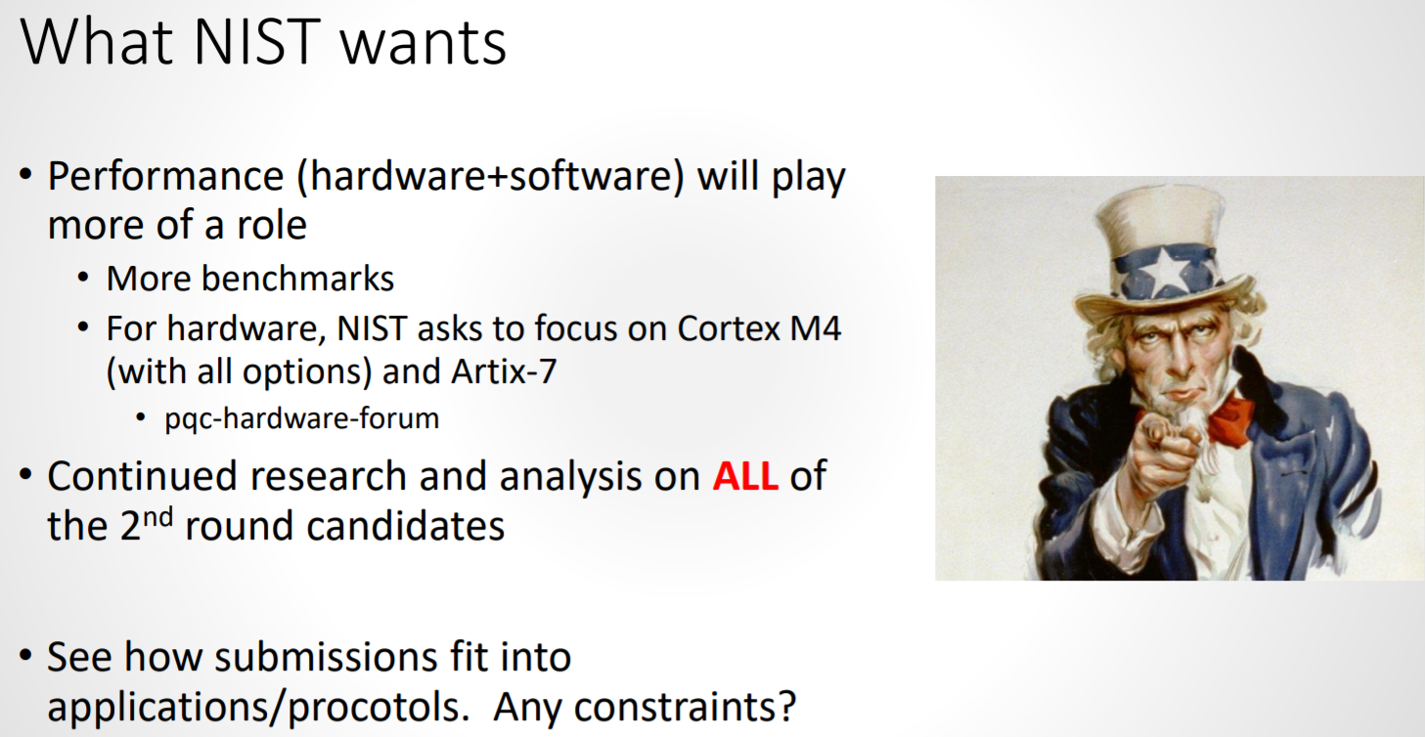
Motivation
In this talk, we address this problem on 32-bit ARM Cortex-M4 processors.

Slide 10
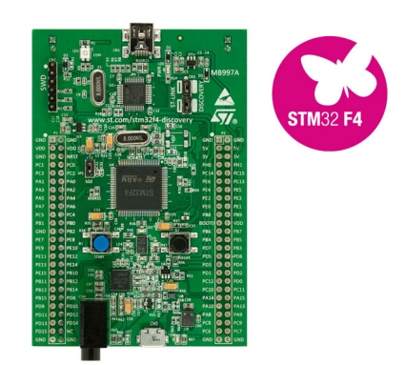
PQC on Low-end Microcontroller
STM32F4DISCOVERY
ARM Cortex-M4
32-bit, ARMv7E-M
192 KB RAM, 168 MHz
Benchmark framework
PQM4: github.com/mupq/pqm4

Slide 11
Previous Works on SIKE/SIDH
64-bit ARM-A processor:
Jalali et al. [SAC’17] → Seo et al. [CHES’18] → Jalali et al. [TDSC’19]→ Seo et al. [WISA’19]
32-bit ARM-A processor:
Koziel et al. [CANS’16] → Jalali et al. [SPACE’18] → Seo et al. [CHES’18]
32-bit ARM-M processor:
This work [CANS’19]

Slide 12
Contribution
Optimized finite field arithmetic: super-scalar implementation
Scalable implementation: well scheduled instruction
Efficient Implementation of SIKE:
p434 (1.94 sec) on 32-bit ARM Cortex-M4 @168MHz

Slide 13
Outline
Short Overview
Supersingular isogeny key encapsulation (SIKE) protocol
Our implementation
Implementation results
Conclusion

Slide 14
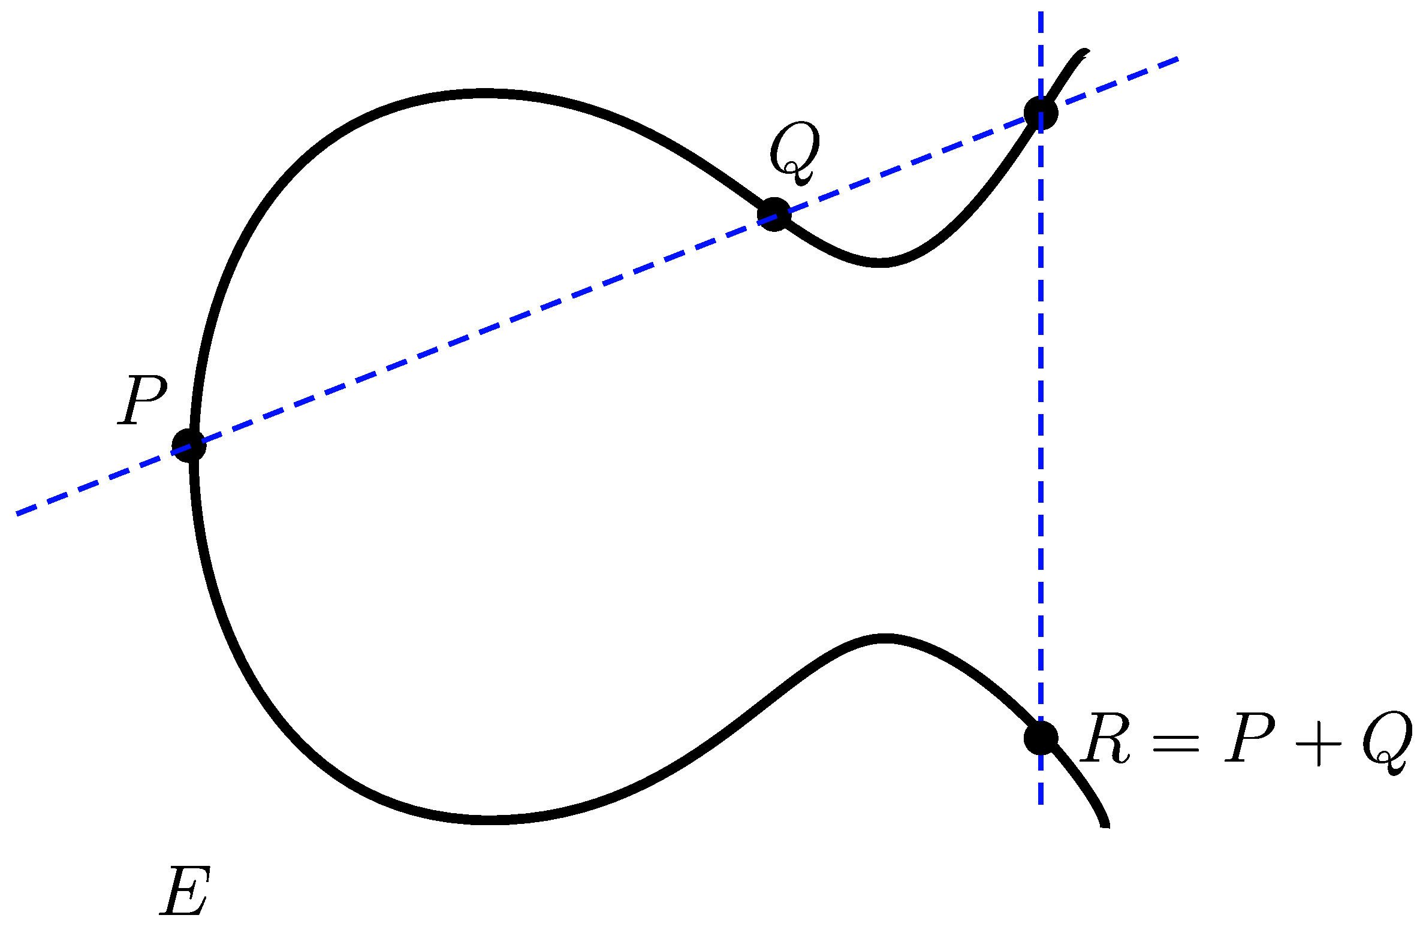
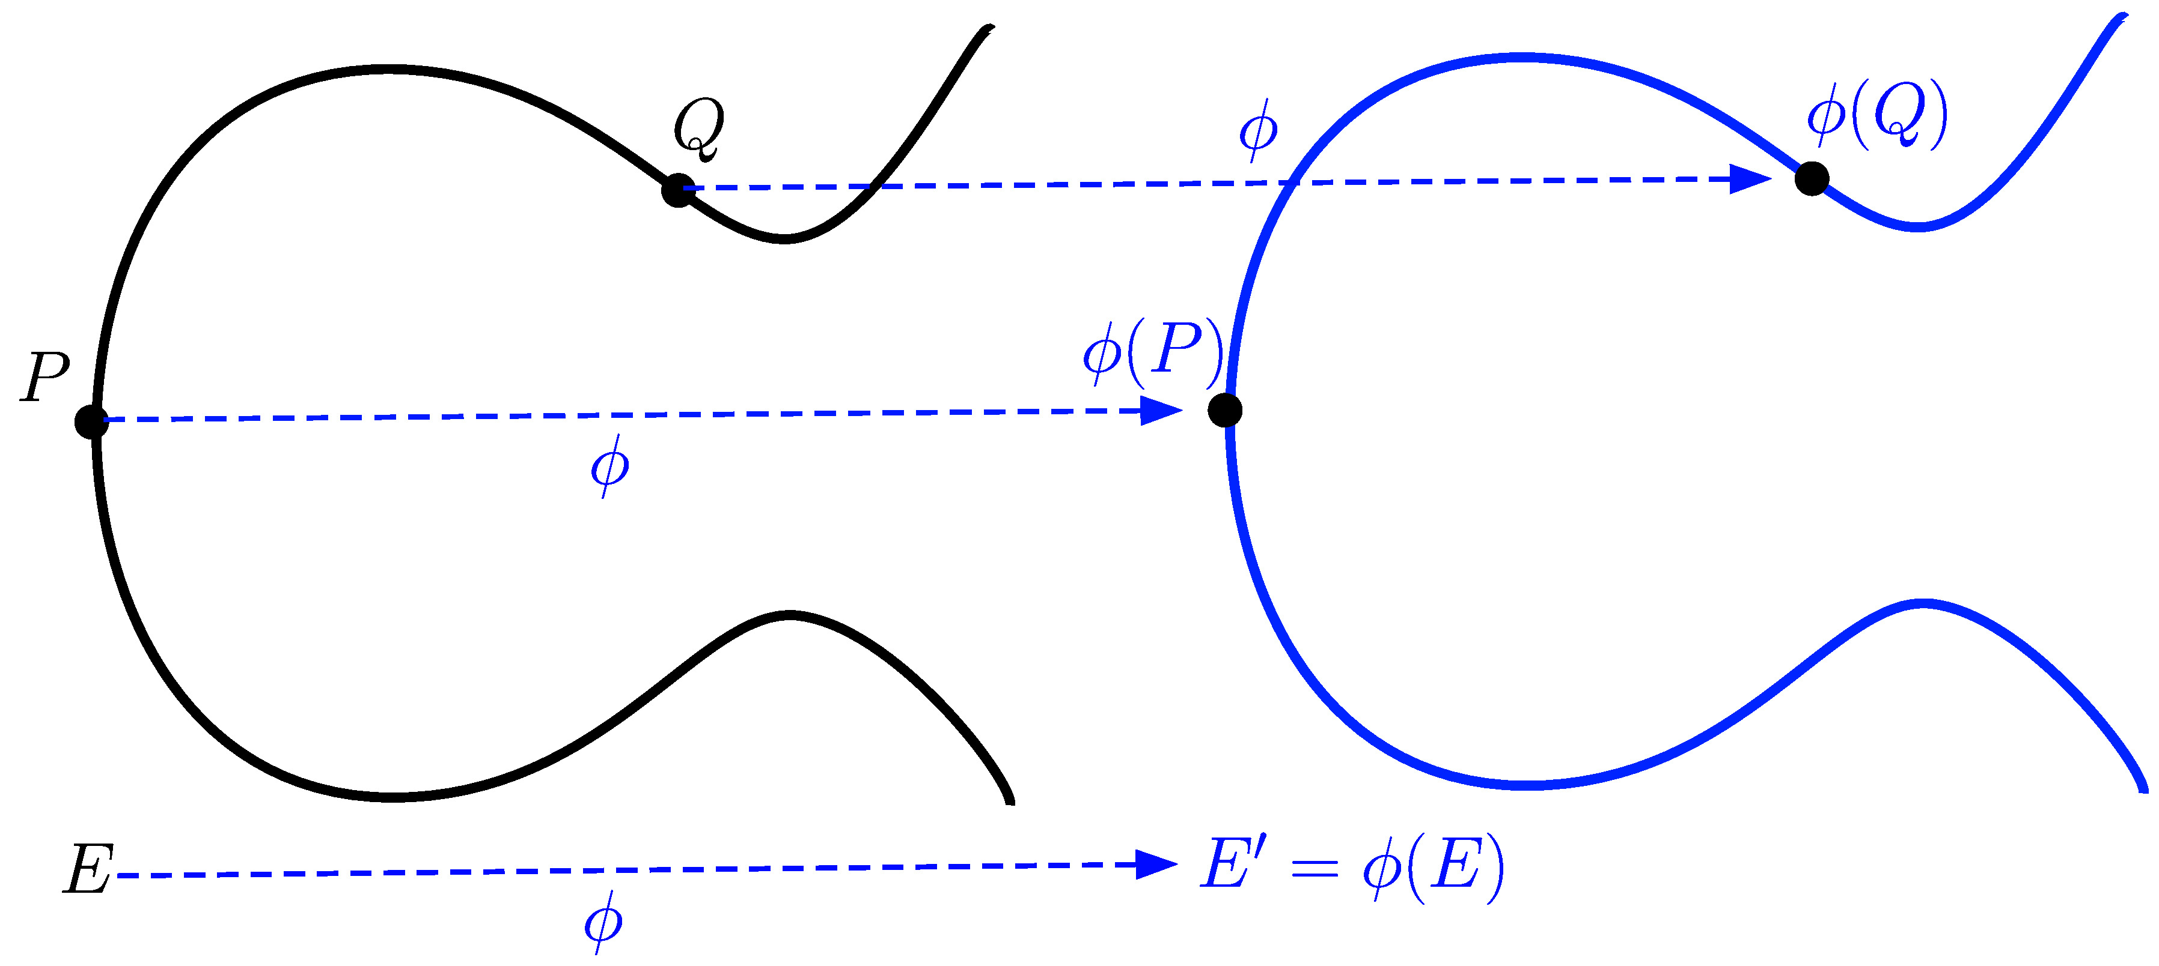

Isogeny-Based Cryptography
Isogeny-based cryptography is constructed on a set of curves.
Given two curve $E$ and $E^{′}=φ(E)$ find $φ$?

Slide 15
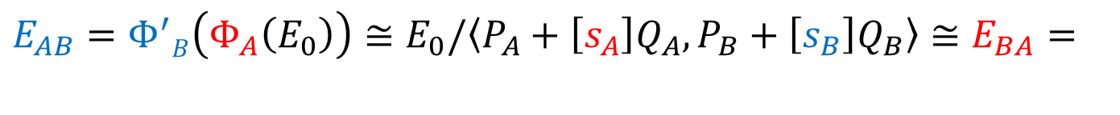


Post-quantum key exchange algorithm
Supersingular Isogeny Diffie-Hellman (SIDH)
Shared key generation between two parties over an insecure communication channel.
SIDH works with the set of supersingular elliptic curves over $𝔽_{p^{2}}$ and their isogenies.
$$E_{AB}=Φ^{′}B\left(Φ_{A}\left(E_{0}\right)\right)≅E_{0}/\left\langle P_{A}+\left[s_{A}\right]Q_{A},P_{B}+\left[s_{B}\right]Q_{B}\right\rangle ≅E_{BA}=$$
$$Φ^{′}A\left(Φ_{B}\left(E_{0}\right)\right)$$

Slide 16
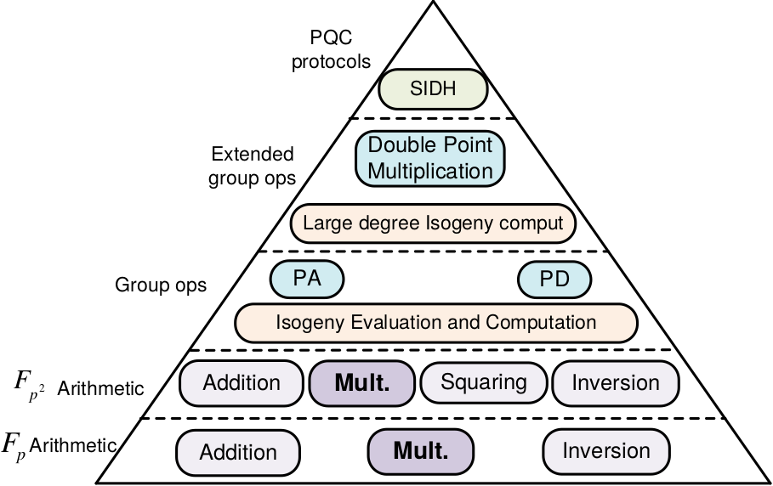
SIDH Computations

Slide 17
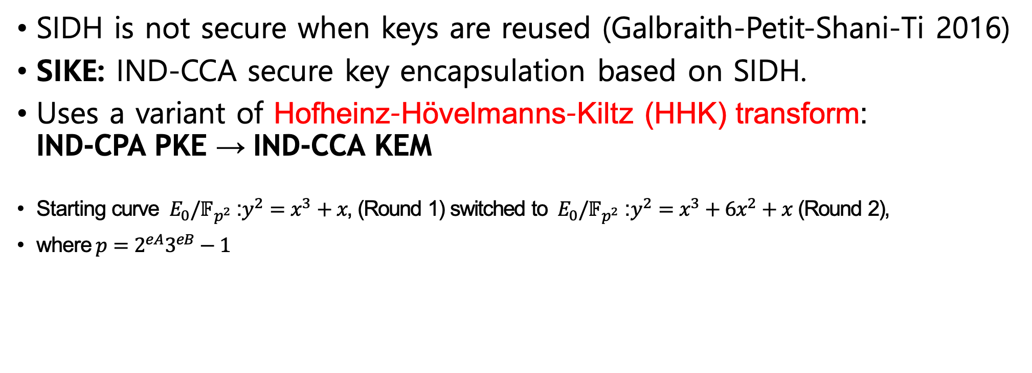
Supersingular Isogeny Key Encapsulation (SIKE)
SIDH is not secure when keys are reused (Galbraith-Petit-Shani-Ti 2016)
SIKE: IND-CCA secure key encapsulation based on SIDH.
Uses a variant of Hofheinz–Hövelmanns–Kiltz (HHK) transform: IND-CPA PKE → IND-CCA KEM
Starting curve $E_{0}/{\text{𝔽}}_{p^{2}}$: $y^{2}=x^{3}+x$, (Round 1) switched to $E_{0}/{\text{𝔽}}_{p^{2}}$: $y^{2}=x^{3}+6x^{2}+x$ (Round 2),
where$p=2^{eA}3^{eB}−1$

Slide 18
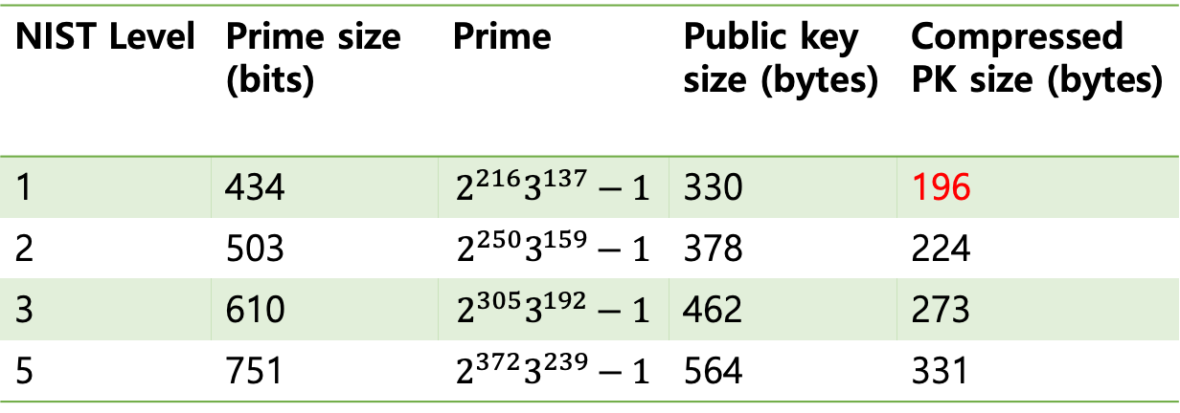
SIKE Key sizes
NIST Level | Prime size (bits) | Prime | Public key size (bytes) | Compressed PK size (bytes)
1 | 434 | $$2^{216}3^{137}−1$$ | 330 | 196
2 | 503 | $$2^{250}3^{159}−1$$ | 378 | 224
3 | 610 | $$2^{305}3^{192}−1$$ | 462 | 273
5 | 751 | $$2^{372}3^{239}−1$$ | 564 | 331

Slide 19
Outline
Short Overview
Supersingular isogeny key encapsulation (SIKE) protocol
Our implementation
Implementation results
Conclusion

Slide 20



Multiplication Instruction (32-bit ARMv7)
32 bits
R0
a0
$$×$$
R1
b0
$$+$$
UMAAL R2, R3, R0, R1
R2
c0
$$+$$
R3
d0
R3, R2
a0b0 + c0 + d0
64 bits

Slide 21
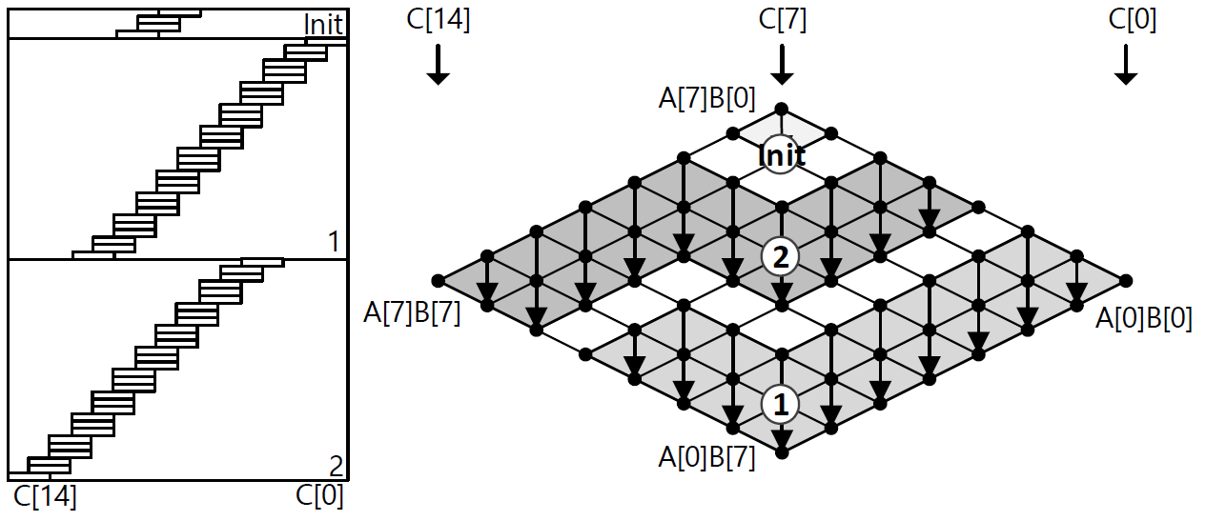
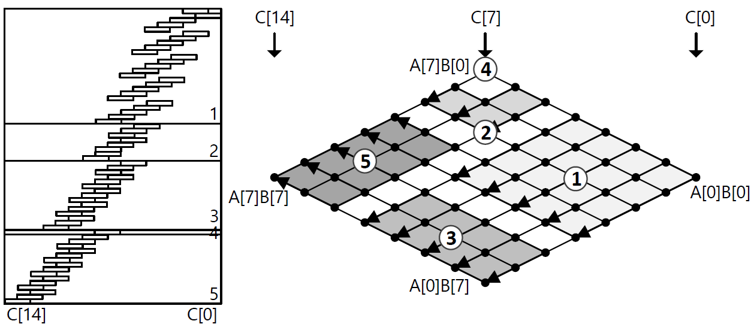
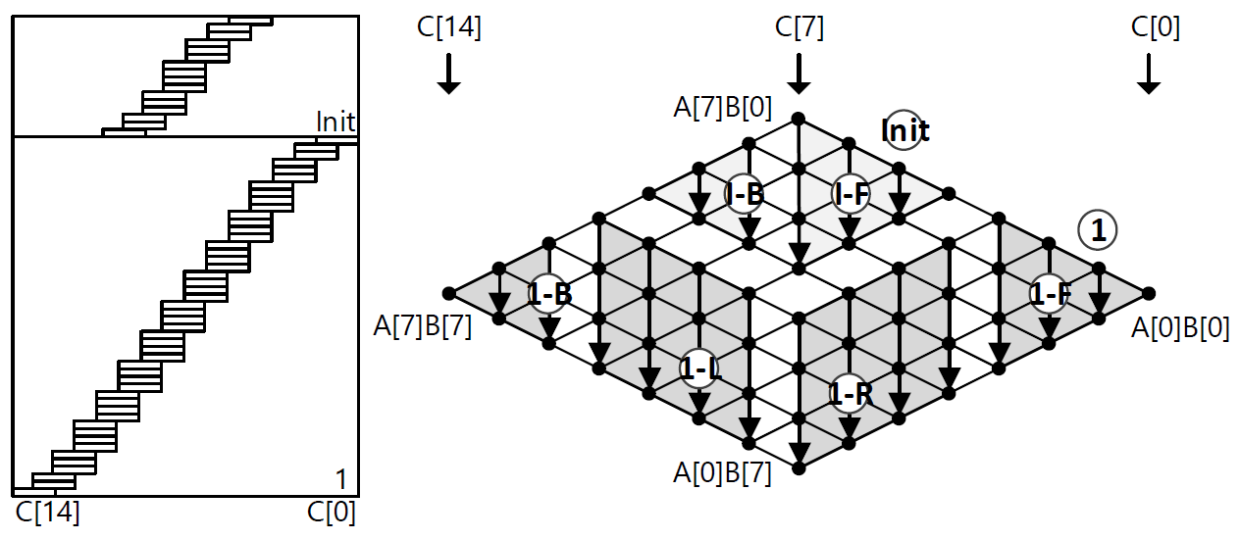
Comparison of Multiprecision Multiplication (32-bit ARMv7-M)
Consecutive Operand Caching (COC)
Operand Scanning (OS)
Requirements for ROC → More registers
Proposed Refined Operand Caching (ROC)

Slide 22
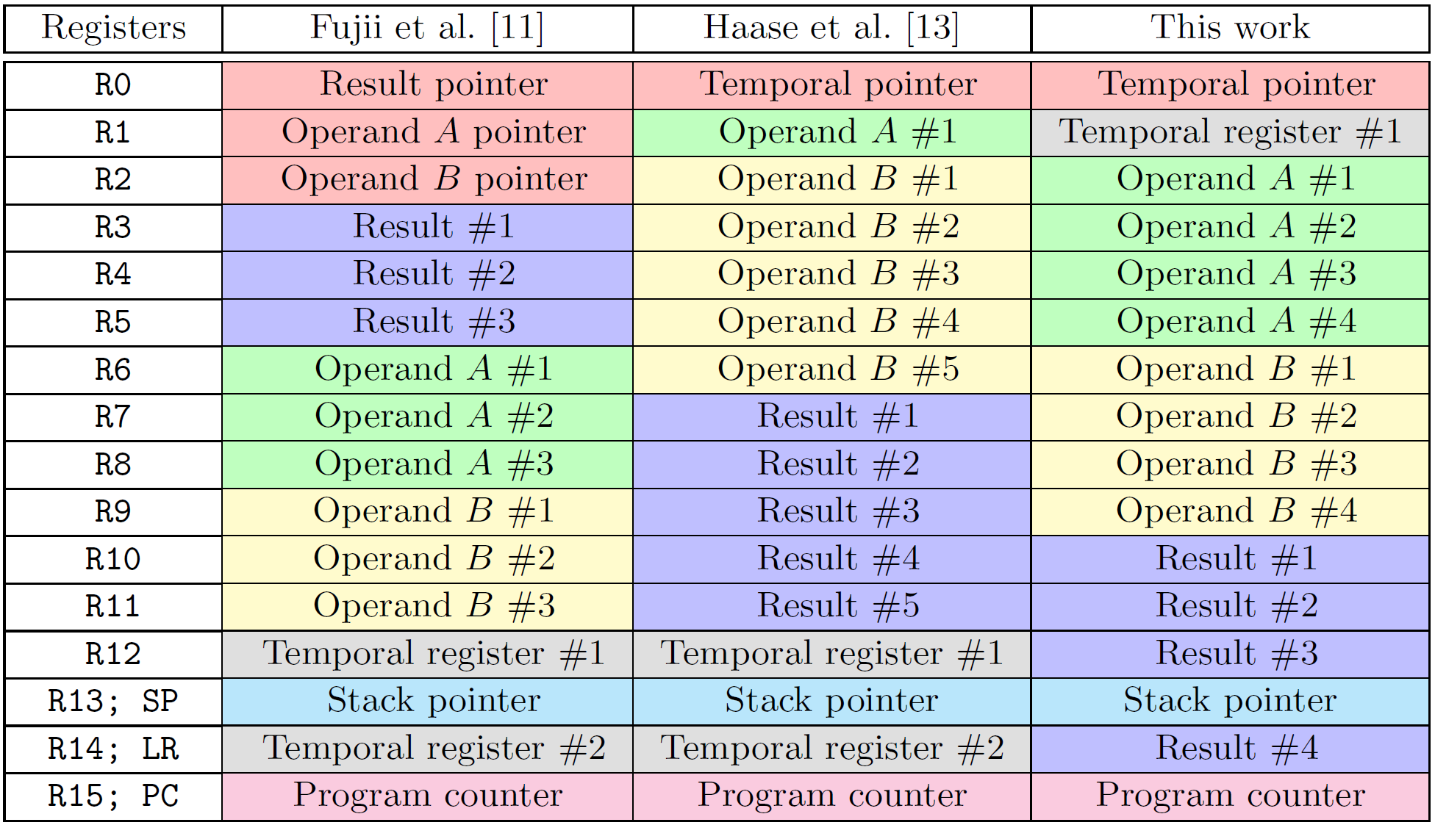
Comparison of Register Utilization

Slide 23
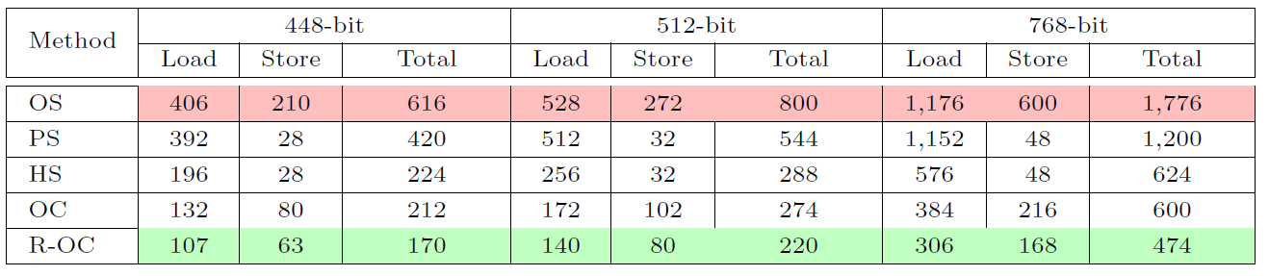
Comparison of Performance
The number of memory access is significantly reduced

Slide 24
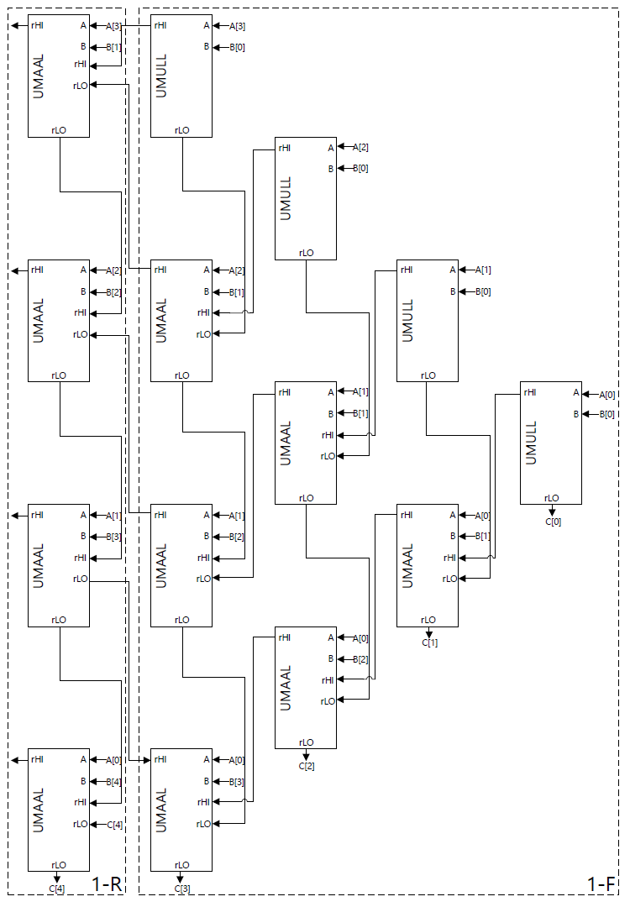
Implementation in Detail
UMULL → Initialize the result registers

Slide 25
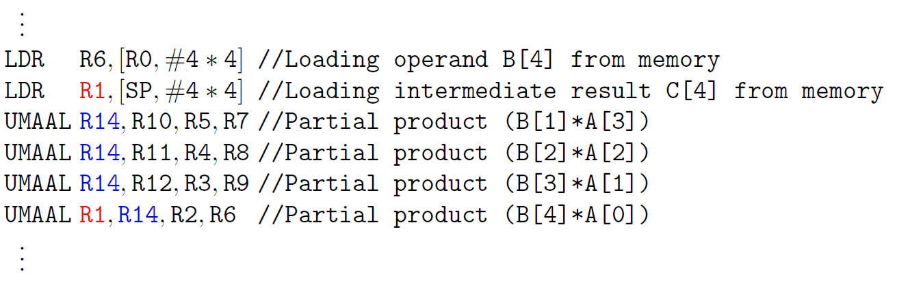
Implementation in Detail
Avoiding the pipeline stall through instruction re-ordering

Slide 26


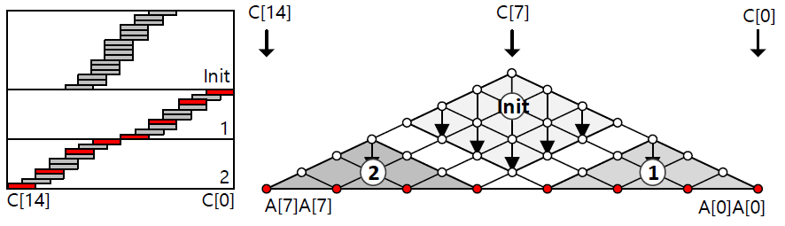
Squaring in Detail

Slide 27
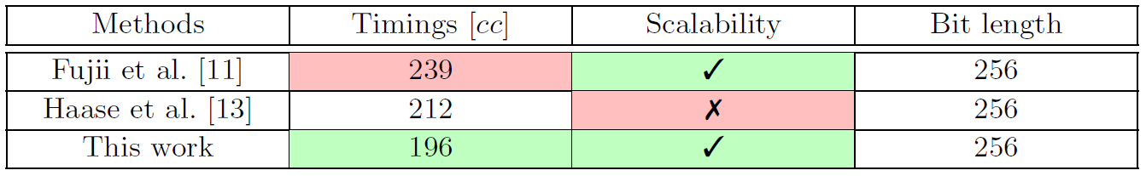
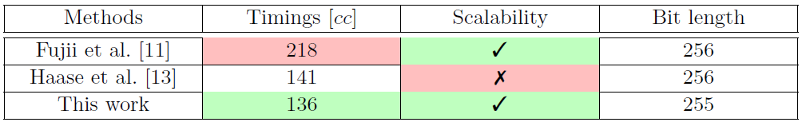
Multiplication/Squaring Result
Multiplication
Squaring

Slide 28
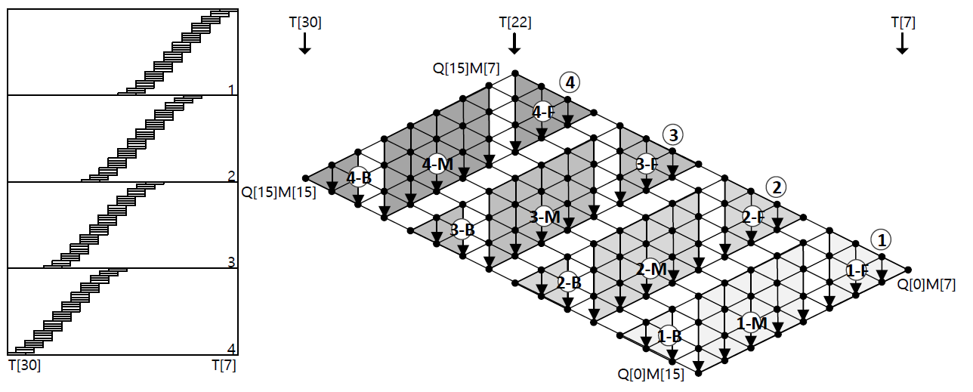
Modular Reduction
Montgomery Reduction: Division → Multiplication

Slide 29
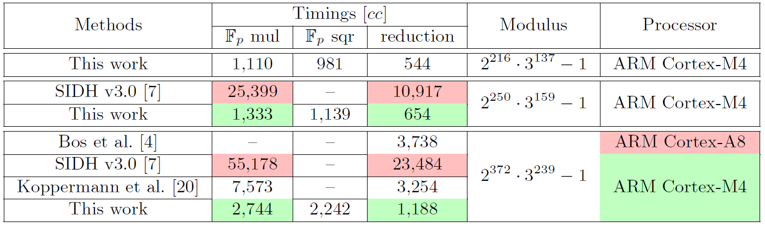
Modular Reduction Result

Slide 30
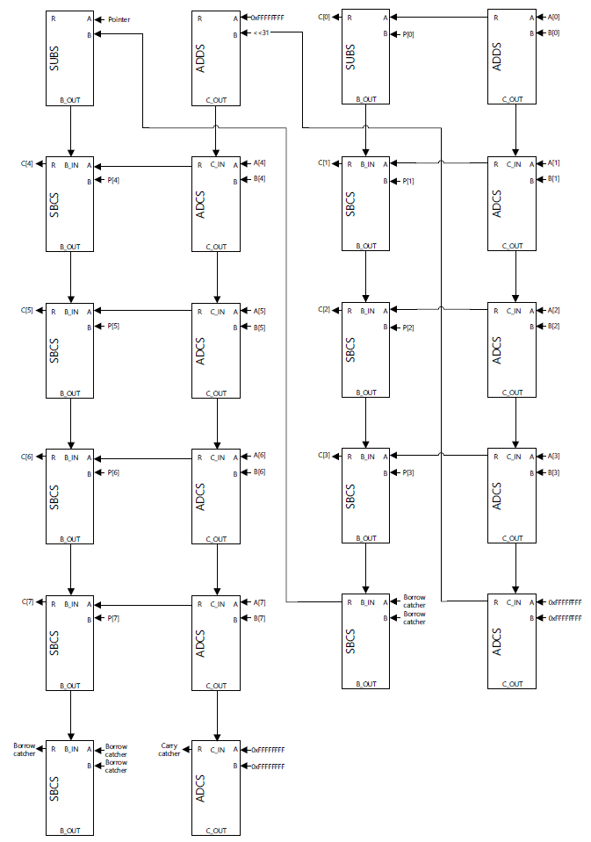

Modular ADD/SUB
Both carry and borrow catcher

Slide 31
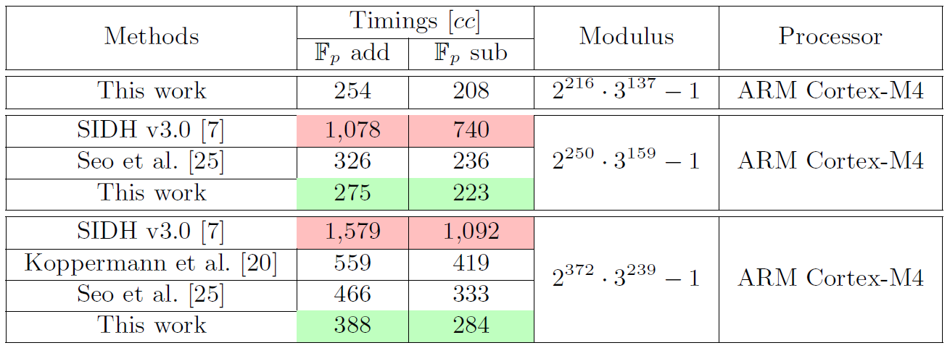
Modular ADD/SUB Result

Slide 32
Outline
Short Overview
Supersingular isogeny key encapsulation (SIKE) protocol
Our implementation
Implementation results
Conclusion

Slide 33
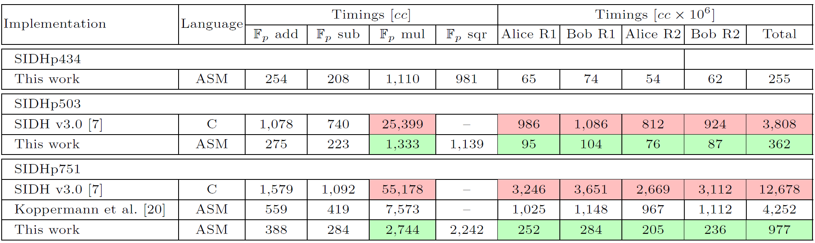
Results
SIDHp503 is about 19x faster than SIDH v3.0 and SIDHp751 is about 2.7x faster than Koppermann et al.

Slide 34
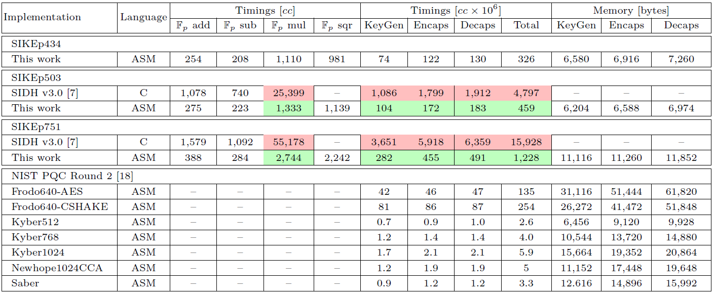
Comparison with NIST PQC

Slide 35
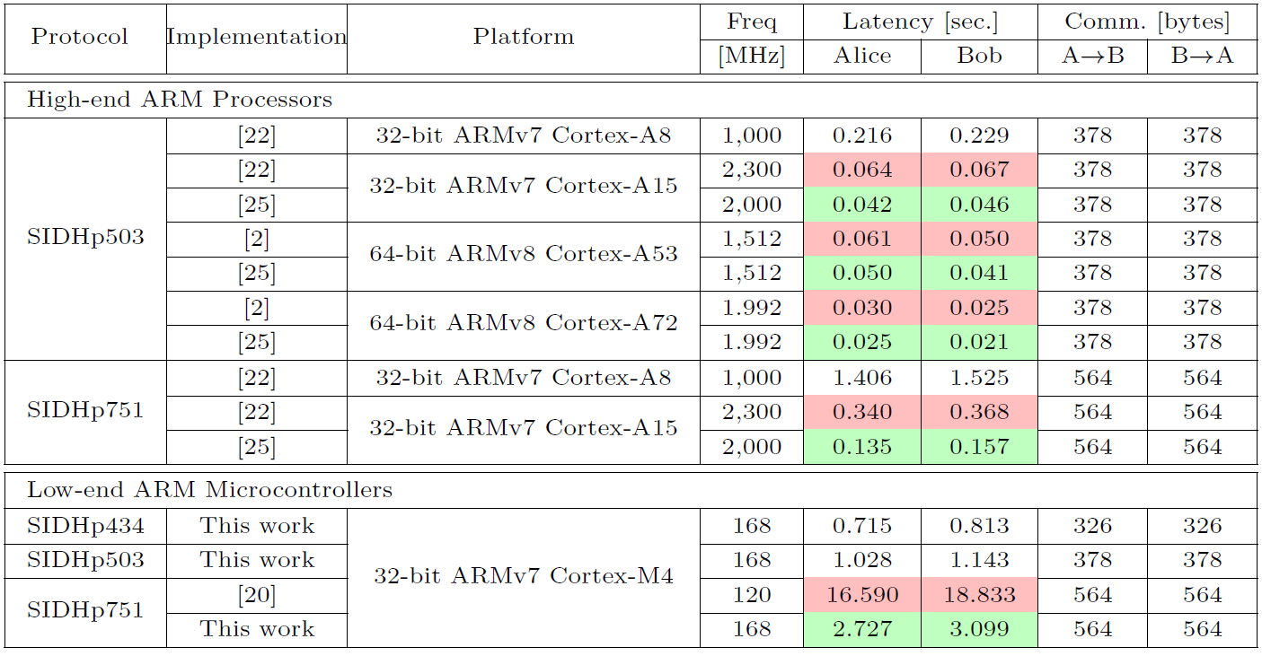
Results on all ARM processors

Slide 36
Outline
Short Overview
Supersingular isogeny key encapsulation (SIKE) protocol
Our implementation
Implementation results
Conclusion

Slide 37
Conclusion
New implementations of finite field arithemtic on ARM
Faster multi-precision multiplication/squaring
Faster Montgomery reduction
Faster modular addition/subtraction
Record-setting SIDH and SIKE implementations
On 32-bit ARM Cortex-M4
Thank you for your attention!

